Slide 1
The Blast Furnace
By Chan, Sam and Elly

Slide 2
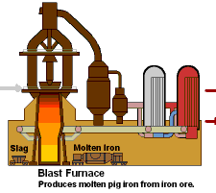
What is a Blast Furnace?
The purpose of a blast furnace is to reduce and convert iron oxides into liquid iron called "hot metal".
The blast furnace is a huge, steel stack lined with refractory brick.
Iron ore, coke and limestone are put into the top, and preheated air is blown into the bottom.

Slide 3
Why does Iron have to be extracted in a Blast Furnace???
Iron can be extracted by the blast furnace because it can be displaced by carbon.
This is more efficient method than electrolysis because it is more cost effective

Slide 4
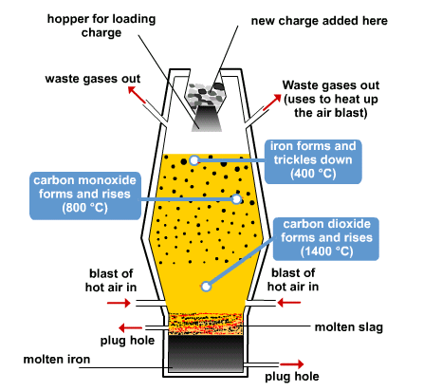

Slide 5
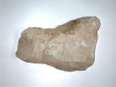
The Method
Three substances are needed to enable to extraction of iron from its ore. The combined mixture is called the charge:
Iron ore, haematite - often contains sand with iron oxide, Fe₂O₃.
Limestone (calcium carbonate).
Coke - mainly carbon
The charge is placed a giant chimney called a blast furnace. The blast furnace is around 30 metres high and lined with fireproof bricks. Hot air is blasted through the bottom.

Slide 6
Several reactions take place before the iron is finally produced...
Oxygen in the air reacts with coke to give carbon dioxide:
C_{(s)} + O _{2(g)} → CO_{2(g)}
The limestone breaks down to form carbon dioxide:
CaCO_{3(s)} → CO₂ _{(g)} + CaO_{(s)}
Carbon dioxide produced in 1 + 2 react with more coke to produce carbon monoxide:
CO_{2(g)} + C_{(s)} → 2CO_{(g)}

Slide 7
The carbon monoxide reduces the iron in the ore to give molten iron:
3CO_{(g)} + Fe₂O_{3(s)} → 2Fe_{(l)} + 3CO_{2(g)}
The limestone from 2, reacts with the sand to form slag (calcium silicate):
CaO_{(s)} + SiO_{(s)} → CaSiO_{3(l)}

Slide 8
Both the slag and iron are drained from the bottom of the furnace.
The slag is mainly used to build roads.
The iron whilst molten is poured into moulds and left to solidify - this is called cast iron and is used to make railings and storage tanks.
The rest of the iron is used to make steel.

Slide 9
Thank you for watching!!!

Slide 10
This powerpoint was kindly donated to www.worldofteaching.com
http://www.worldofteaching.com is home to over a thousand powerpoints submitted by teachers. This is a completely free site and requires no registration. Please visit and I hope it will help in your teaching.

